Slide 1


Outbreak Investigation
MSc Clinical Epidemiology
Dr Ola Adetokunboh MD PhD
Division of Epidemiology and Biostatistics,
Faculty of Medicine and Health Sciences
Stellenbosch University
July 2020

Slide 2
Session objectives
After completion of this session you should be able to:
Definition of an outbreak
Outline how outbreaks are detected
Explain the reasons for investigating disease outbreaks
Outline the key steps in investigating a disease outbreaks

Slide 3
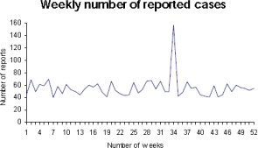
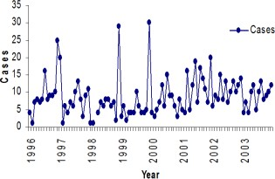
What is an outbreak?
Occurrence of more cases of disease or other health problem than normally expected:
among a group of people or in a specific place
over a specified period of time

Slide 4
What is an epidemic?
Occurrence of more cases of illness, or other health related events in excess of normally expected
Synonymous with the term ‘outbreak’
Some reserve the term ‘epidemic’ to more widespread
Larger geographical area
More prolonged
Has more than one focal point.
Term ‘epidemic’ known to raise alarm in the population

Slide 5
What is a disease cluster?
A geographical or temporal collection of cases that is suspected to be greater than expected in a certain place and/or time
May turn out to be an outbreak or not
Warrants investigation
Outbreak investigations often begin with identification of a suspected cluster of cases

Slide 6
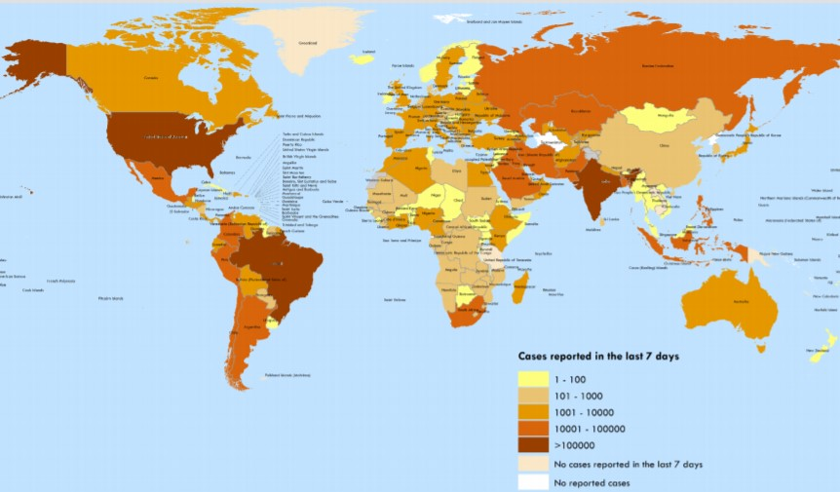
What is a pandemic?
If an outbreak occurs over a very wide area affecting a large proportion of the population in several countries or continents the Director General of the WHO can declare it a pandemic
‘Pan’ all
‘Demos’ people
COVID-19 global spread

Slide 7
Scenario
You are the Communicable Disease Control Coordinator for eThekwini District health department.
You are informed that 17 residents of a shelter for disabled people have been diagnosed with MDR TB since January 2019
Is this an outbreak of TB?

Slide 8
How do we get to know about outbreaks?
Public health surveillance data
Health care practitioners
Clinicians, infection control professionals, laboratorians
Patient or patient's family
Local media
Newspaper, television and radio
Professional networks
Promed Digest

Slide 9


Why should we investigate outbreaks?
Primarily to STOP the outbreak
To know what is causing the outbreak
Mode of transmission
Risk factors
Institute control measures
To know magnitude of problem
Severity of illness
Morbidity and mortality
Potential for further spread
Effectiveness of control measures

Slide 10
Why should we investigate outbreaks?
It is our mandate as a health department
In an outbreak situation everyone looks up-to us to do something
Need to reassure the public
To improve our knowledge
Understand more about the disease (research)
Prevent future outbreaks
Train new field staff

Slide 11
Which diseases require investigation?
Epidemic prone diseases
E.g. cholera, meningococcal meningitis, etc
Diseases targeted for eradication or elimination
Polio, neonatal tetanus, measles, malaria
Even a single case requires investigation
Internationally important diseases with high case fatality rates
Yellow fever
Outbreaks of unknown aetiology or unclear mode of spread

Slide 12
Role of epidemiology during outbreaks
Identification of the outbreak
Through disease surveillance
Systematic description of outbreak
Identification of risk factors
Using descriptive or analytical methods
Identification of interventions
Implement/recommend control measures
Evaluate the impact of control measures

Slide 13
Summary steps in outbreak investigation
i.
ii. iii. iv.
v.
vi. vii.
viii. ix.
x.
xi. xii.
Prepare for field work Verify the diagnosis
Determine the existence of an outbreak
Identify and count cases
Analyse the data -person, place & time Formulate and test hypothesis
Assess the local response capacity
Set up immediate control measures Address the resource gaps
Prepare written report
Disseminate/communicate the findings Intensify surveillance

Slide 14
Why are the steps important?
Provides a systematic way of approaching an outbreak
Helps to collect sufficient and relevant information
Ensures you don’t miss out critical information
Allows to make a quick and accurate diagnosis of outbreak
Implementation of appropriate control measures

Slide 15

Prepare for field work
Gather as much information about outbreak and population at risk
Assemble a team –Outbreak Response Team
Ensure relevant supplies and equipment
Transport media, specimen bottles, IEC, treatment guidelines & medical supplies, transport, communication means, investigation forms, funds, etc
Alert next level –district, province, national
Familiarize with the disease
Consult and read further

Slide 16

Verify the diagnosis
Rule out misdiagnosis, laboratory errors, etc
Discuss with attending clinician
Review clinical findings
Visit patients yourself (interview and examine for symptoms and signs)
Discuss with laboratorian -confirm laboratory testing (diagnosis)
Ensure that all the cases have the same disease

Slide 17
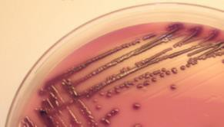
Verifying the diagnosis –to note!
Be careful when interpreting negative laboratory results…
Illness could be due to an organism that wasn’t tested for
Specimens could have been collected too late in the illness
Mishandling of the specimen

Slide 18

Establish existence of an epidemic
We said an outbreak is the occurrence of more cases of a disease than expected in a population at a particular time
But how can you know the expected number of cases??

Slide 19
Establish existence of an epidemic
Compare observed incidence with the expected for that place at that point in time
For reportable diseases use surveillance data
For other diseases and conditions, look for existing data locally –e.g. hospital admission or discharge records
If data not readily available may have to conduct a telephone survey of physicians, laboratories, etc
Conduct a survey of the community to establish the background or historical level of disease.

Slide 20
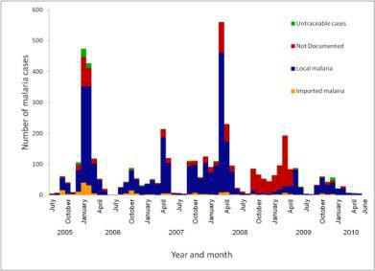
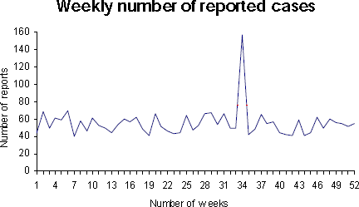
Establish existence of an epidemic
Be careful when comparing the incidence:
Seasonal disease: compare incidence from similar periods of earlier years
Not seasonal disease: compare with incidence from previous weeks/ months

Slide 21
Establish existence of an epidemic
Can use alert and action thresholds
A cut-off that alerts public health officials to take action is set at certain level above the expected
Use past data to calculate a baseline and decide if an event is abnormal
Help identify possible outbreaks using surveillance data
Alert threshold and action thresholds differ depending on the disease

Slide 22
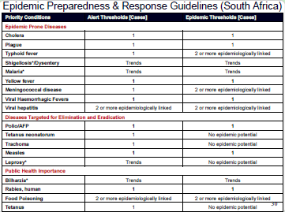

Slide 23
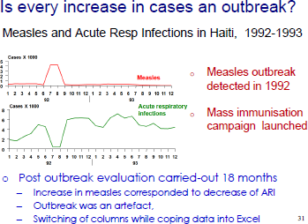

Slide 24
Our previous TB scenario…..
During the initial investigation of the outbreak you gather the following information:
400 residents live at the home, including 43 children with cerebral palsy
256 staff taking care of the residents
2010 and 2011 –No TB cases diagnosed
2012 –3 cases & 1 died (residents), 3 cases & 1 died (staff)
2013 (Jan-August) –9 cases & 2 died (residents) and 2 cases (staff)
Does this confirm an outbreak of TB?

Slide 25
Systematically identify & count cases
Choose a working case definition
Criteria for deciding if a person should be classified as suffering from the disease under investigation
In building a case definition we usually include:
Clinical and/or biological criteria –signs & symptoms
Epidemiologic criteria –time, place, person
Laboratory criteria –in some diseases
Case definition should be highly sensitive at beginning –
tighten as more information is gathered

Slide 26
Systematically identify & count cases
Using the working case definition
Collect information on cases and deaths
Identifying information: name, physical address.
Demographic: age, sex, tribe.
Clinical: symptoms and signs, date of onset, lab results, Rx, outcome of Rx.
Exposure and risk factor information
Record the information on a line listing

Slide 27
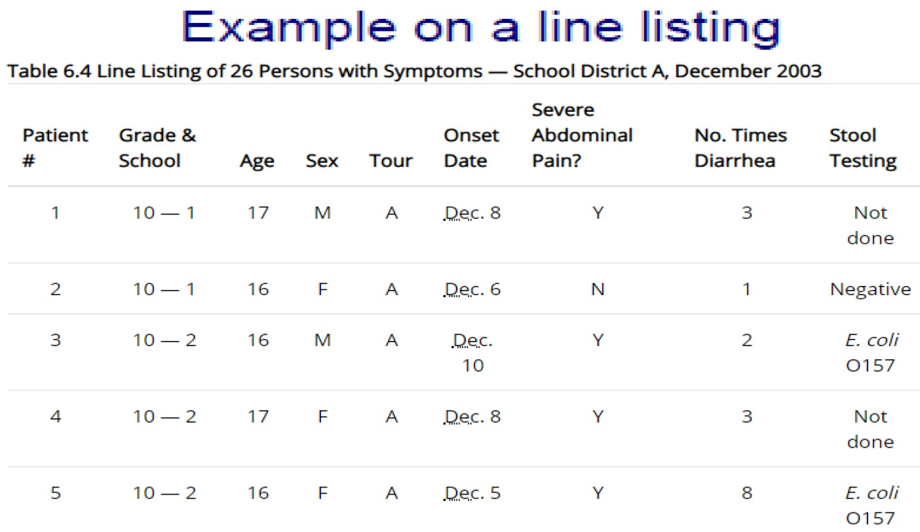

Slide 28
Systematically identify & count cases
Where do you look for the cases?
Health care facilities where the diagnosis is likely to be made -physicians , clinics, hospitals, laboratories.
May decide to alert the public directly e.g. through the local media.
Contact tracing –to identify contacts to case-patients
Conduct a survey of the entire population.

Slide 29

Remember –Time is crucial
Steps are not in any fixed order –most can be done
concurrently depending on the situation
Our main task is to STOP the outbreak
Implement control and preventive measures throughout

Slide 30
Descriptive data analysis
Analyse the data that you have collected this far
Use the information from the line list
May provide clues or information about
−Magnitude & extent of the outbreak
−Sub-populations that are most affected
−Target interventions for control + prevention
−Generate hypotheses about source / cause

Slide 31
Analyse data by time
Distribution of cases by date or time of onset
May answer the questions:
What is the exact period of the outbreak?
What is the probable period of exposure?
Is the outbreak likely common source or propagated?
Was the outbreak response effective?

Slide 32
Epidemic curve
A graph that shows the no of new cases of disease over time
Useful tool in any outbreak investigation
Provides visual representation of time course of the outbreak
May help to understand cause of an epidemic
- Agent , route of transmission, exposure period, incubation period, etc
Useful in evaluating the effectiveness of an intervention or control measure implemented
Traditionally displayed using a histogram

Slide 33
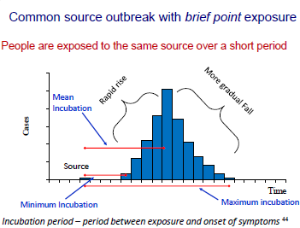

Slide 34
Exercise: What epi-curve pattern would you expect in the following scenarios?
21 cases of shigellosis among children and workers at a day care center over a period of 6 weeks, no external source identified (incubation period for shigellosis is usually 1—3 days)
36 cases of giardiasis over 6 weeks traced to occasional use of a supplementary reservoir (incubation period for giardiasis 3–25 days or more, usually 7–10 days)
43 cases of norovirus infection over 2 days traced to the ice machine on a cruise ship (incubation period for norovirus is usually 24–48 hours)

Slide 35
Analyse data –by person
Shows which people are at highest and lowest risk of illness?
Demographic characteristics:
Age, gender, marital status, race distribution
Possible exposures:
Occupation, source of drinking water, food consumed, etc

Slide 36
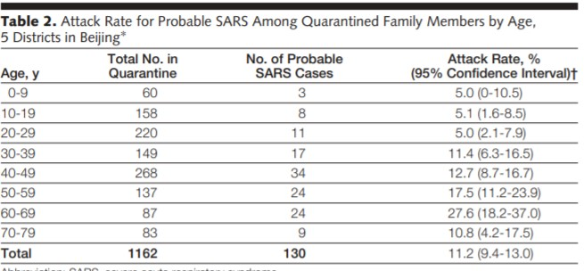
Descriptive analysis of data by person
Outbreak in Beijing, 2003. JAMA. 2003;290(24):3215-3221
Pang et al. Evaluation of Control Measures Implemented in the Severe Acute Respiratory Syndrome Evaluation of Control Measures Implemented in the Severe Acute Respiratory Syndrome Outbreak in Beijing, 2003JAMA. 2003;290(24):3215-3221

Slide 37
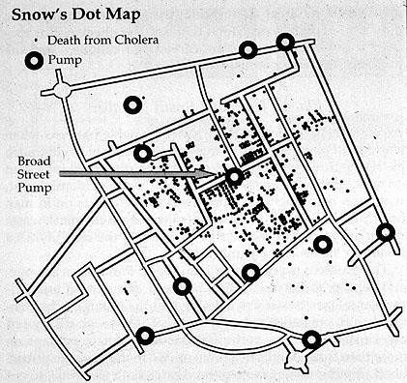
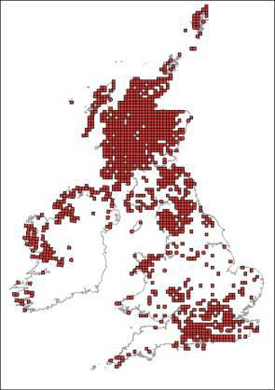
Analyse data - by place
Illustrates the geographic extent of the outbreak
Can provide important etiologic clues
Clustering of cases
Display the data using
Spot map -where cases live, work, or may have been exposed
Graphs or tables, e.g. number of cases by province

Slide 38
Analyse data –by possible exposures
Depending on the disease, possible exposures may include
Food consumed,
Drugs administered,
Occupation,
Place of residence,
Vaccination status
Source of drinking water
Important for generating hypothesis regarding possible source of outbreak

Slide 39
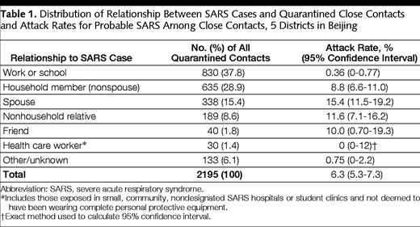
Analyse data -by possible risk factors

Slide 40
Formulate hypothesis
Hypothesis should address
Source of the agent
Mode of transmission
Exposures (risk factors)
In formulating the hypothesis
What is the agent’s usual reservoir?
How is it usually transmitted?
What vehicles are commonly implicated?
What are the known risk factors?

Slide 41
Test hypothesis –case-control design
Consider a case-control study design to investigate an outbreak when:
Affected population is wide and not well defined
The cases of disease are very few
Little is known about the risk factors for illness and multiple exposures are of interest
If the disease takes a long time to develop
Approach
Compare ill persons (cases) with well persons (controls)
Calculate odds ratios

Slide 42
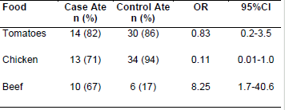
Example -Case control design

Slide 43
Test hypothesis –cohort study
Consider cohort study design for outbreak when:
When outbreak is in a small, well defined group: e.g. food borne illness after wedding party
If very few people have been exposed to the hypothesized exposure –want to
enroll as many exposed as possible
Approach
Retrospective cohort is more efficient in most outbreak situations
Compare exposed persons with non exposed persons
Calculate attack rates in exposed and compare with attack rate in unexposed
(attack rate ratio/relative risk)

Slide 44
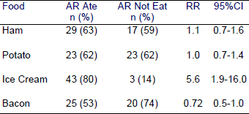
Example: Analysis in a cohort study

Slide 45
Verify hypothesis –other investigations
The epidemiological investigation is only a component of the outbreak investigation
Other investigations should support/compliment the epidemiological analysis
Microbiological investigation
Environmental investigation
Veterinarian investigation - e.g. Herds supplying milk
Trace back investigations (origin of foods)
Entomological investigations

Slide 46
Assess the local response capacity
Depending on magnitude of outbreak
The investigation should be linked to a response to control/stop the outbreak
To come up with comprehensive interventions and recommendations the ORT should assess the available response capacity
Number and type of staff is available locally?
Which supplies are available to treat the cases?
What has been done in terms of response?
What steps have been taken to interrupt transmission?

Slide 47
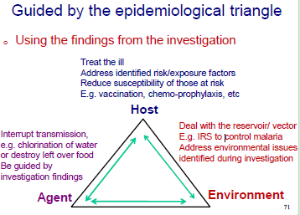
Set up immediate control measures

Slide 48
Control measures -example
Controlling a food borne outbreak may involve:
Destroying contaminated foods
Recalling a batch of contaminated food from the market
Slaughtering infected animals
Treating an infectious food handler
Providing chemoprophylaxis to those exposed

Slide 49
Address resource gaps
Depending on available capacity, done as need may arise:
Clinical supplies –drugs, vaccines, etc
Personnel
Laboratory support.
Environmental support.
Public information.
Transport, communication and other logistics.

Slide 50

What is an outbreak report?
A document summarizing the proceedings, main findings and recommendations of the outbreak field investigation

Slide 51
Why should we write outbreak reports?
To document the outbreak
Permanent reference for the future
Provides a forum for reflection and review
Encourages a systematic, critical approach
To substantiate and share recommendations
Blue print for any action

Slide 52
Why should we write outbreak reports?
It is a reporting requirement -a way of communicating investigation findings to:
Colleagues –public health community,
Scientific community,
Supervisors
Public
Media, etc

Slide 53
Types of reports in field investigation
Field reports are created at various stages of the field investigation
Four main types of field investigation reports:
Notification of investigation
Preliminary report
Interim report
Final report

Slide 54
What should be included in the report?
Describe the situation using the information gathered in the above steps.
Describe what has happened so far guided by the steps discussed
Describe the need for additional assistance (if any), depending on resource gaps identified.
Make conclusions on the outbreak
Give recommendations on priority activities based on findings and conclusions -short term, long term

Slide 55
Basic structure of final outbreak report
Summary
Introduction/ background information
Aims & objectives of investigation
Methods
Results
Description of response
Results of response
Self evaluation and lessons learned
Discussion
Conclusions and recommendations
Appendices

Slide 56
Disseminate information
Distribute the report to those who need to know
Investigation team and other key stakeholders
District/Provincial health department, local authority
Partners you are working with
Do not forget to inform the public of:
likely causes of outbreak
risks of contracting the disease
essential control steps, etc.
Also remember the media

Slide 57
Intensify/maintain surveillance
Use surveillance to monitor outbreak
Maintain contact with the local staff for daily updates until the epidemic is over
Implement active surveillance during period of outbreak –to get more timely and complete data
Enhance the routine passive disease reporting system during the outbreak –to collect more information
New cases –admissions, outpatients, discharges etc
Deaths,
New areas affected, etc
May need to implement laboratory surveillance –depending on situation

Slide 58
Keep in mind
Most steps in outbreak investigation can be done
concurrently
Our main reason for investigating an outbreak is to be able to
STOP the outbreak
Implement control and preventive measures throughout the investigation

Slide 59
Recap of session objectives
We have come to the end of the session –by now you should be able to:
Definition of an outbreak
Outline how outbreaks are detected
Explain the reasons for investigating disease outbreaks
Outline the key steps in investigating a disease outbreak

Slide 60
Acknowledgment
Dr Ude Obike
Dr Lazarus Kuonza (South Africa FELTP South Africa Regional Disease Detection Centre, National Institute for Communicable Diseases)

Slide 61
THANK you

